Slide 1
Allusion & Symbol
in Literature: rich possibilities

Slide 2
Allusion
A reference within a written work to something outside it:
Types of Allusions in literature:
Historical (refer to a war/king)
Biblical (events in the Bible)
Classical (Greek/Roman lit.)
Personal (writer’s experiences)
Literary (events or characters from literature)

Slide 3
Journal Entry #6
Choose five of the objects in the front of the classroom and write one way each object could be used in a story as a symbol or an allusion.

Slide 4
Allusion Challenges:
A writer using allusion takes for granted that he has a reader with knowledge and experience similar to his own whether through reading or personal experience.
Best help for understanding allusions:
READ!

Slide 5
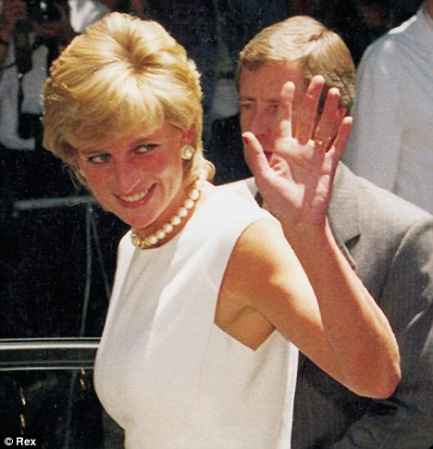
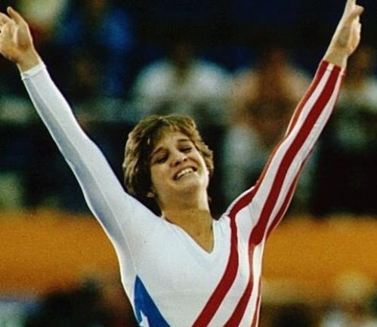
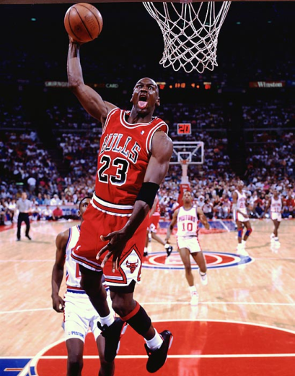
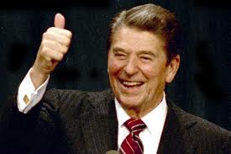

Slide 6
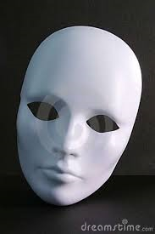
Symbol
A literary symbol:
A person, place, thing, or idea within a narrative or poem that means something in addition to itself.
It is both a literal object in the text and a window into further meaning beyond itself.
For example: Babylon in the Bible is both a city AND a symbol of sin and the kingdom of this world.

Slide 7
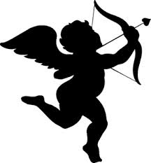
“Cupid’s Arrows”
Plot: based on the love triangle
Allusions
Cupid (the boy god, son of Venus … shoots two kinds of arrows)
Diana (cousin of Venus, known for her skill in archery)
Judgment of Paris (the incident that caused the abduction of Helen)
Theme
The precedence of love over position and money in the choice of a mate

Slide 8
Announcements:
Essay due Monday
Vocab is next week.
Test is Wednesday.

Slide 9
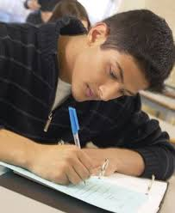
“Outta My Way, Grandpa!”
O’Neill’s essay is full of humor. His colloquial style reminds readers that literary devices are available to every speaker of English, not just literary heavyweights.
Experiment with these literary devices!

Slide 10
“The Progress of Poesy”
Title
Poesy=the creative imagination, specifically in writing poetry.
Progress=a royal journey or advance
Three main ideas
Growing older
Advancing/declining in creativity
Searching for water

Slide 11
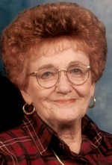
Stanzas
1=creativity flows in youth
2=creativity is channeled and disciplined in middle age but starts to dry up
3=creativity dies in old age (agree?)
Allusions
Arid mount/mute mount=the Law on Mt. Sinai
Striking the rock for water=Moses’ smiting the rock for water
Old man lying down to die=Moses’ being buried in the mountains of Edom

Slide 12
“Maggie and Milly and Molly and May”
Literal meaning
Four girls go to the sea and each finds out something different according to their personalities.
Symbolic meaning
Maggie=finds music in nature, poetic, forgets everything when she can be artistic
Seashell=universal symbol for imagination
Milly=tenderhearted, friendly to the friendless
Molly=fearful, notices the scary
May=sentimentalist, mysterious

Slide 13
Gum-Free Zone
Cell Phone-Free Zone

Slide 14
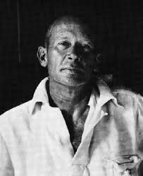
“Maggie and Milly and Molly and May”
Moral:
Choices (or responses to surroundings) reveal personality and character.
Can you think of a verse to back this up?
Author, E.E. Cummings
American 20th-century author
Wrote shaped poetry
Used unconventional format (capitalization, punctuation, word order)
Philosophy: no absolutes

Slide 15
Bad … good? Balance?
Introvert
Extrovert
Quiet
Loud
Leader
Sensitive
Perceptive

Slide 16
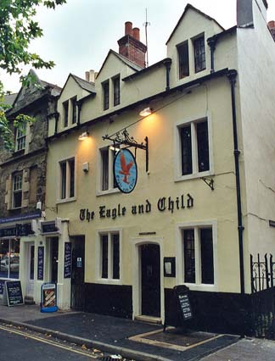
G.K. Chesterton

Slide 17
Literary Terms: Unit 3
Atmosphere: the overall emotion pervading a work
What is the atmosphere of Edgar Allan Poe’s works?
Tone: the attitude of the author toward his or her subject.
Austen’s tone in her novels tells us how she feels about certain issues.
What is Dickens’ tone in many of his novels?
Persona: the person created by the author to tell the story.
Does not always agree with the author’s view.

Slide 18
Edgar Allan Poe

Slide 19
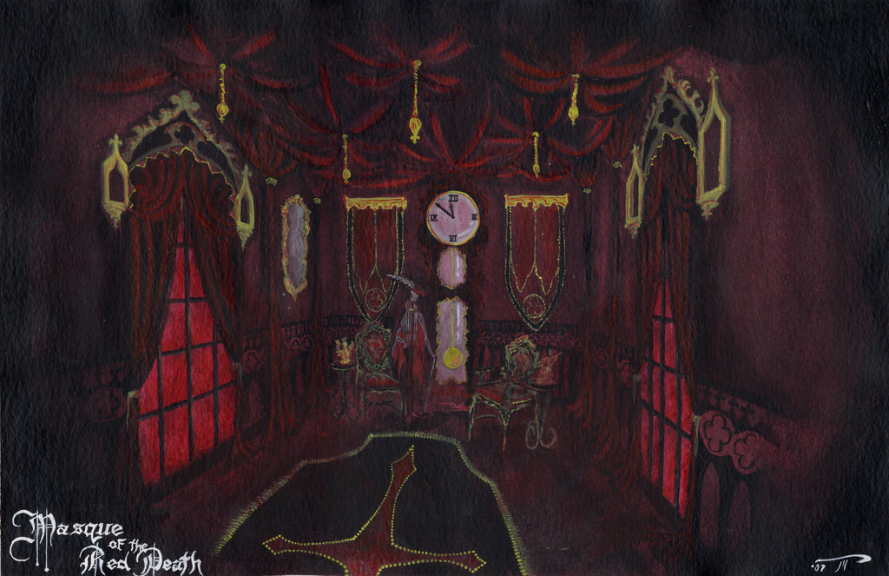
“The Masque of the Red Death”
Background
The Black Death: killed millions, was transmitted to humans by fleas and rodents
Hemorrhages under the skin caused it to turn black.
Setting
Masquerade: opulence, pleasures within the abbey
Stages of life represented by the rooms:
Blue=birth
Purple=experience
Green=youth, growth
Orange=maturity, autumn
White=old age, winter
Violet=darker experience
black with red panes=the “Red Death”

Slide 20
“The Masque of the Red Death”
Theme
The plague cannot be halted by man-made barriers because death is everywhere present with us.
Prospero symbolically travels the course of a life through each room and stops in the black room.
The futility of his attempt to remove the specter (human death) is thematically significant.
The conflict, characters and plot seem to point to the futility of man’s attempt to escape the clutches of death.
Universality of Poe’s theme
Poe leaves the reader with the depressing realization of man’s inevitable demise.
Philippians 1:12-28—what should be our attitude about life and death as children of God?

Slide 21
Other Poe works:
The Fall of the House of Usher
The Pit and the Pendulum
The Tell-Tale Heart
The Cask of Amontillado
The Purloined Letter

Slide 22
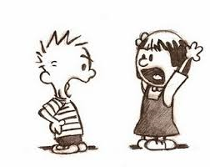
Literary Terms: Unit 3
Conflict: the opposition of two or more forces in a work.
External Conflicts: those that occur between a character and an outside force (such as society or nature).
“Return of the Rangers,” “Masque of Red Death”
Internal Conflicts: those that occur between a character and his own thoughts, emotions, or beliefs.
“Outta My Way, Grandpa,” Romeo & Juliet

Slide 23
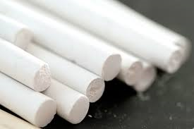
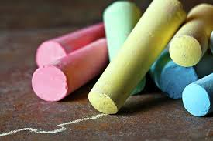
“A Piece of Chalk”
An essay that provides many examples of literary devices.
Examples of modes of excellent literature: See handout
Message
White=virtue, not race; virtue is not a passive thing, but rather a proactive thing, “shining and affirmative,” “fierce” and “definite,” “vivid” and “flaming.”
England=a force for virtue for the world

Slide 24
Quiz Review:
Study all notes from Power Point slides.
Be familiar with the writers and works (matching?)
Be familiar with the literary devices studied in this unit:
Allusion
Symbol
Conflict
Atmosphere

